Slide 1
MODULE-3
Camera calibration

Slide 2
Camera Calibration
Camera converts 3D image to 2D image
Camera calibration estimates parameters of camera to
--correct for lens distortion,
--measure the size of an object
--determine the location of the camera in the scene.
Intrinsic parameters (focal length, optical center etc)
extrinsic parameters(rotation, translation etc)

Slide 3
Camera Model
Simulates the capture of light from 3D scene- onto to a 2D image
Models basic geometry of projections of 3D points/curves/surfaces

Slide 4
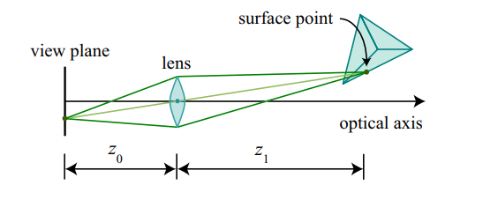
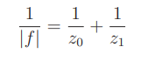
Thin Lens Model
modern cameras use a lens to focus light onto the view plane
This is done so that one can capture enough light in a sufficiently short period of time
In the thin lens model, rays of light emitted from a point travel along paths through the lens, converging at a point behind the lens.

Slide 5
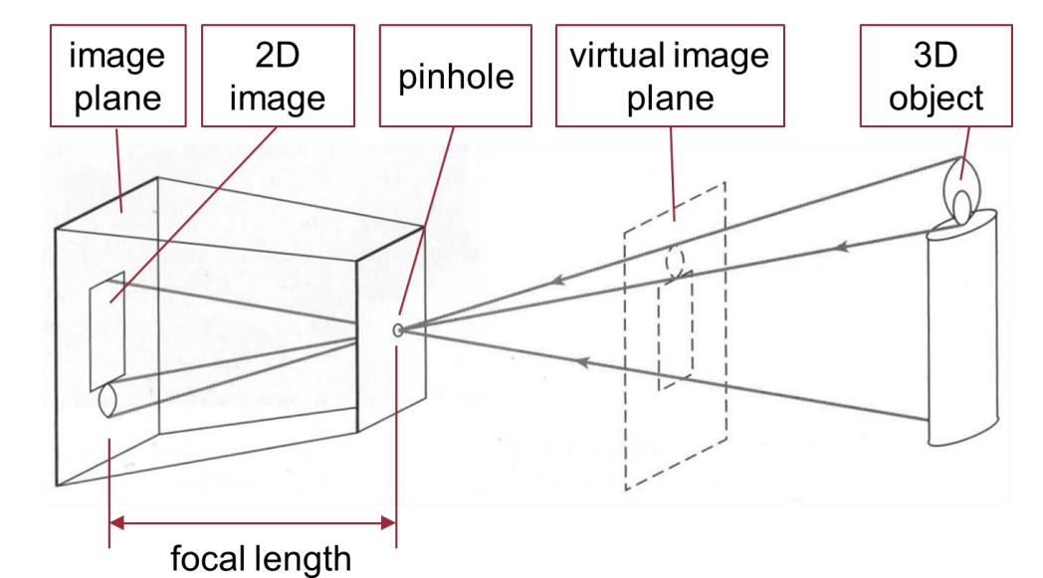
Pinhole camera model
Light from a point travels along a single straight path through a pinhole onto the view plane.

Slide 6
Geometric Transformations
Translation
Rotation
Scaling
Skewing

Slide 7
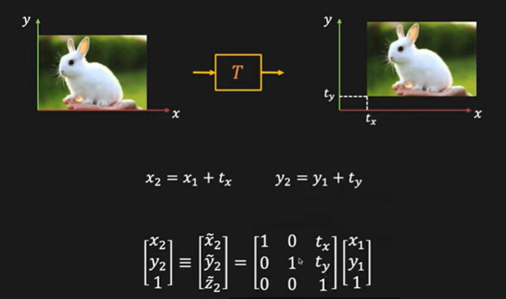
Scaling

Slide 8
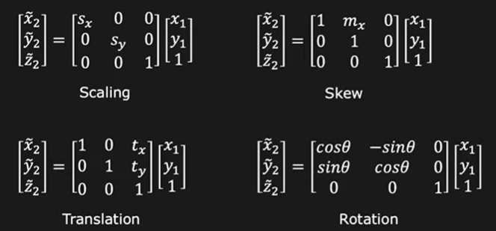

Slide 9
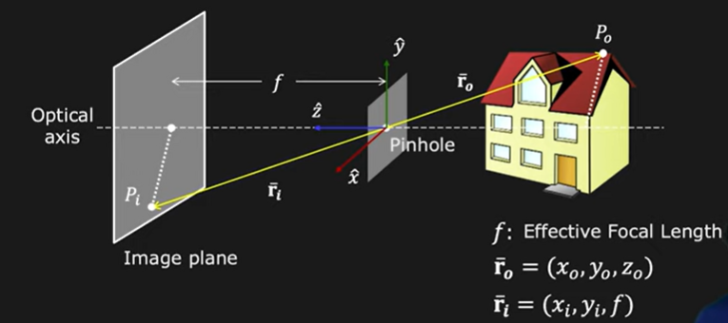
Point P0 is projected at point Pi on image plane
Optical axis is the axis that is perpendicular to the image plane
Focal length (f) is the distance between the image plane and pinhole

Slide 10
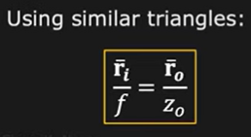
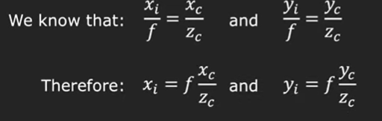

Slide 11
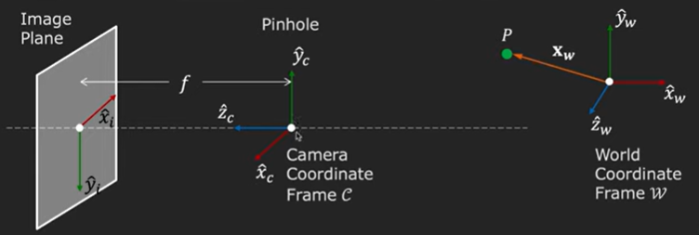
Transformation from world coordinate to Image coordinates

Slide 12
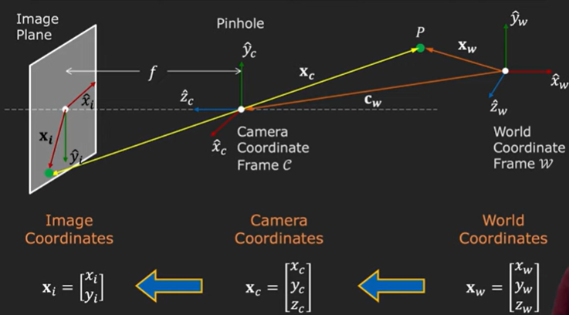
Transformation from world coordinate to Image coordinates (3D→2D)
Perspective projection
Coordinate transformation

Slide 13
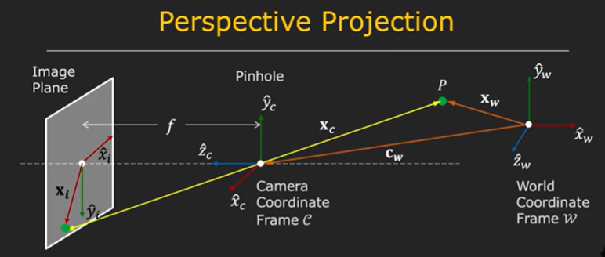
Perspective projection

Slide 14
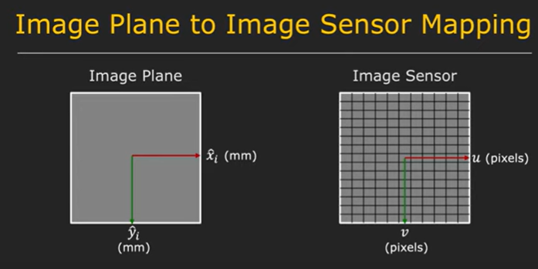
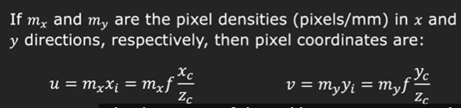

Slide 15
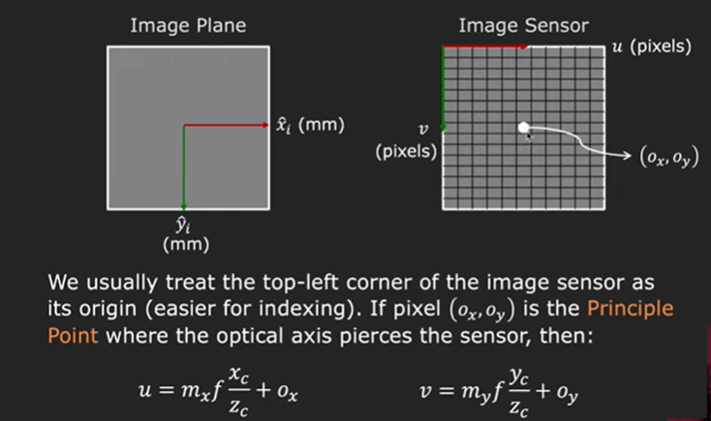

Slide 16
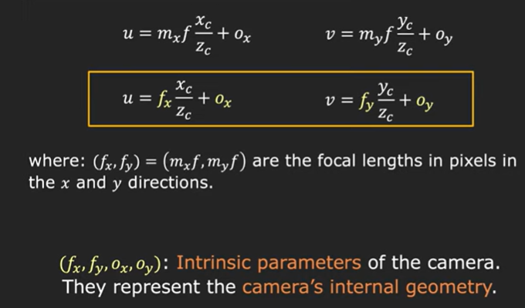

Slide 17
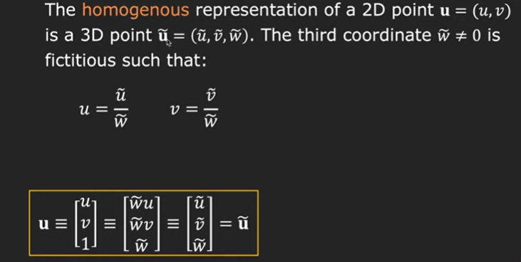

Slide 18
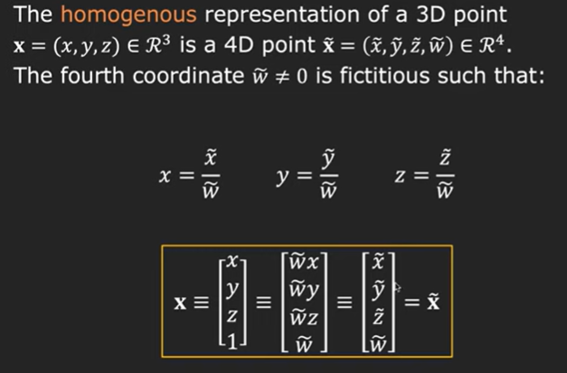

Slide 19
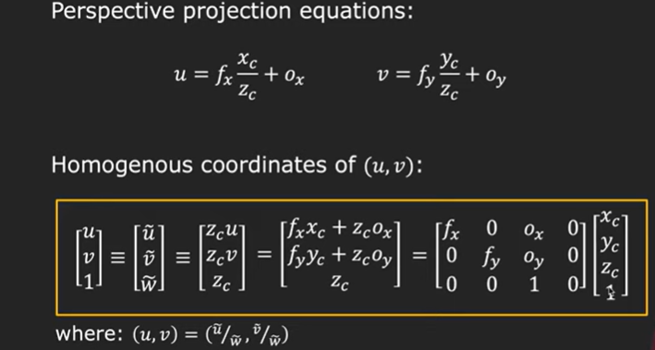
Linear Model for Perspective Projection

Slide 20
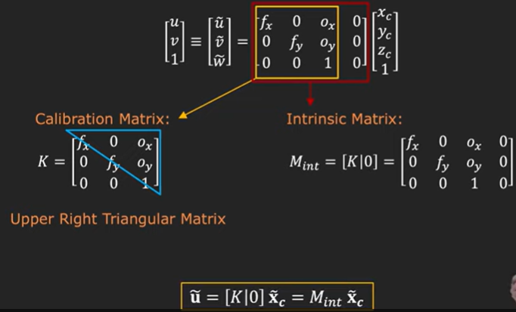

Slide 21
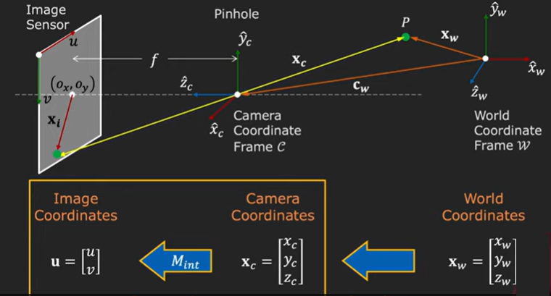

Slide 22
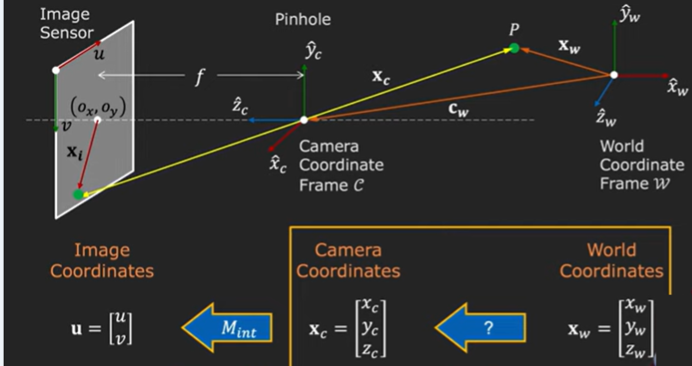

Slide 23
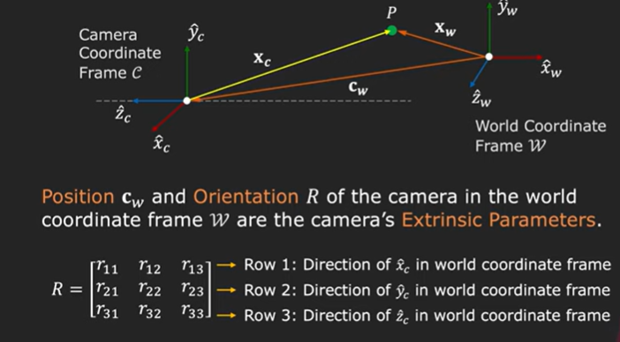
Extrinsic Parameters

Slide 24
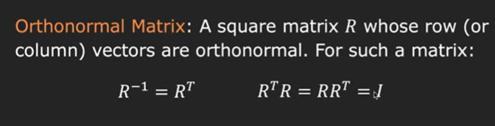
Rotation matrix ‘R’ here is Orthonormal matrix

Slide 25
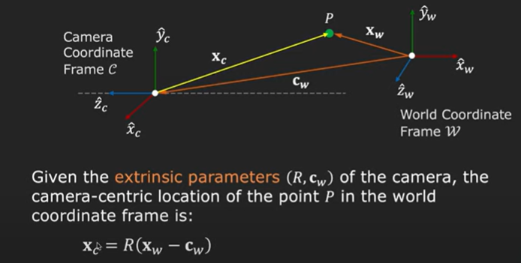

Slide 26
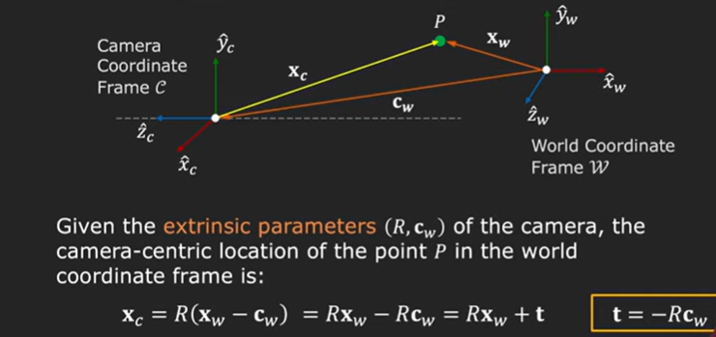

Slide 27
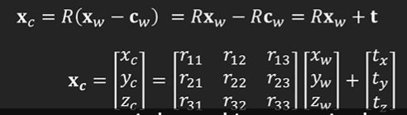
‘t’ is the translation vector and is given by t= -Rc_{w}

Slide 28
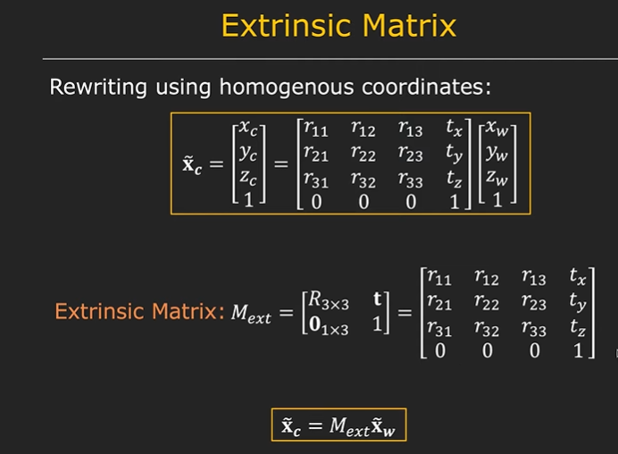
Mapping from world coordinates to camera coordinates using EXTERNSIC MATRIX

Slide 29
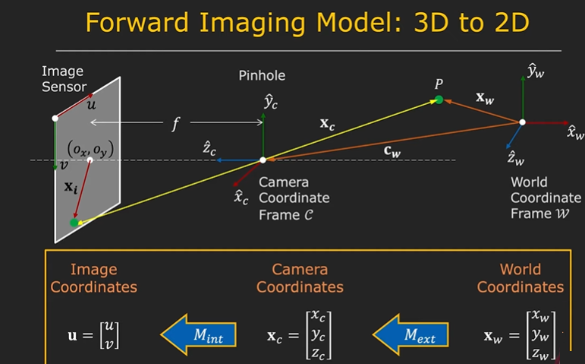

Slide 30

CALIBRATION PATTERNS
To estimate the intrinsic and extrinsic parameters, we need 3-D world points and their corresponding 2-D image points.
You can get these correspondences by using images of a calibration pattern
calibration pattern (calibration grid / calibration target) is a repeating pattern of known size and spacing.
Checkerboard
Asymmetric circles
symmetric circles

Slide 31
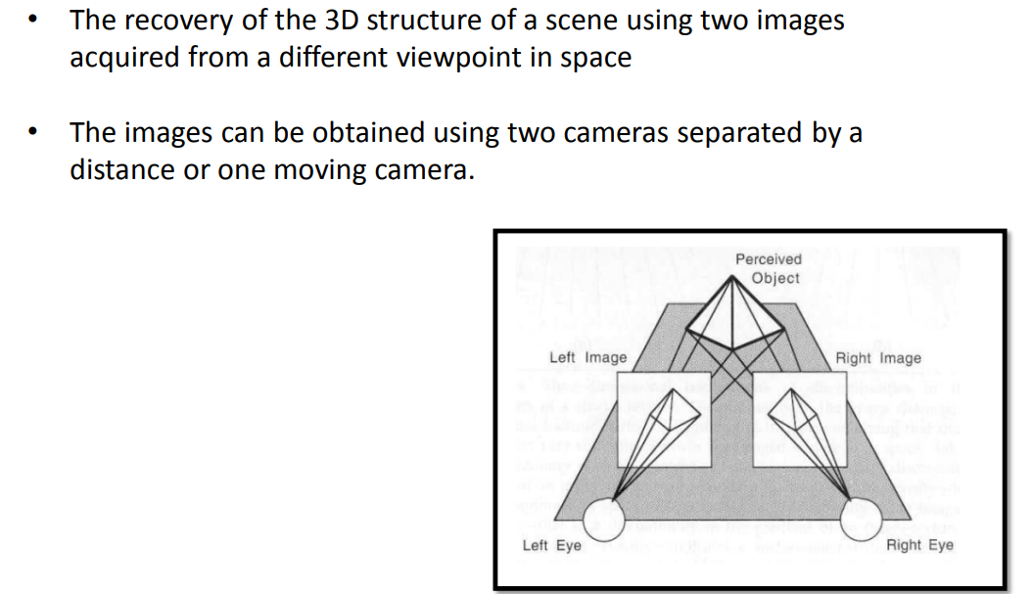
Stereo correspondence

Slide 32
Stereo correspondence→ is the process of taking two or more images and estimating a 3D model of the scene by finding matching pixels in the images and converting their 2D positions into 3D depths.
In visual perception, we perceive depth based on the differences in appearance between the left and right eye
Eg: hold your finger vertically in front of your eyes and close each eye alternately.
Application: robotic navigation, 3D model building

Slide 33
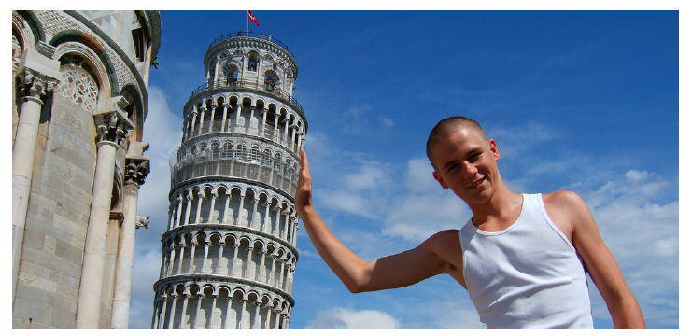
However, in general, it is not possible to recover the entire structure of the 3D world from just one image. During 3D to the 2D mapping, some information is simply lost.

Slide 34
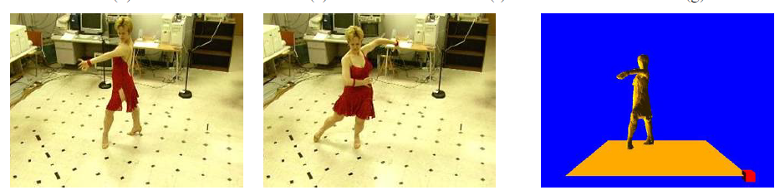
3D model construction

Slide 35
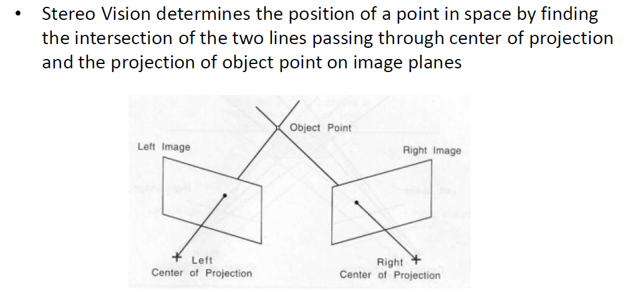
Triangulation – Principle underlying Stereo Vision

Slide 36
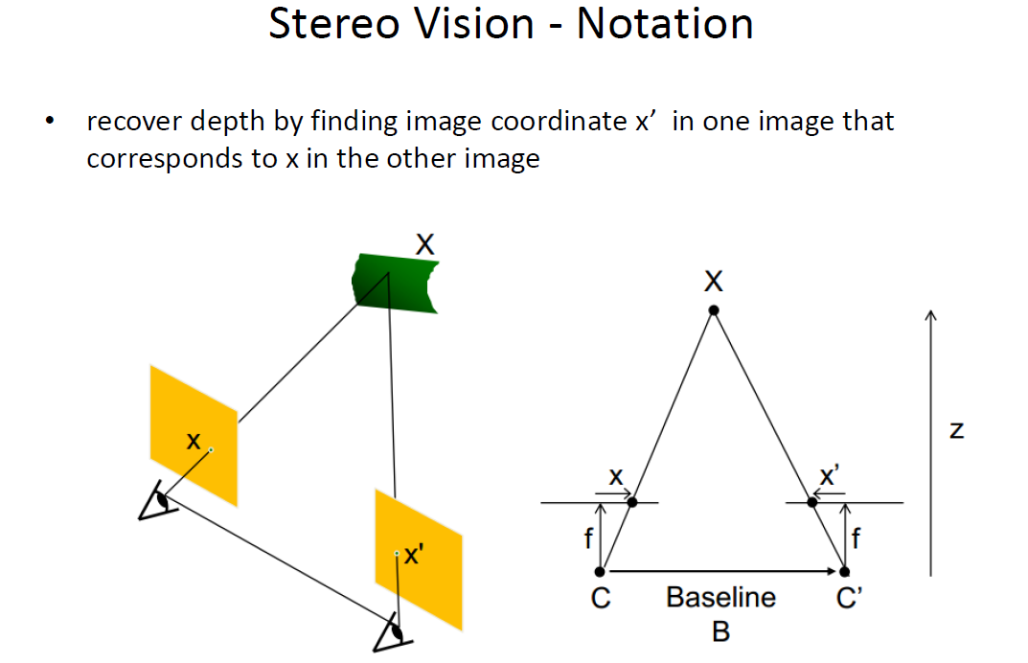

Slide 37
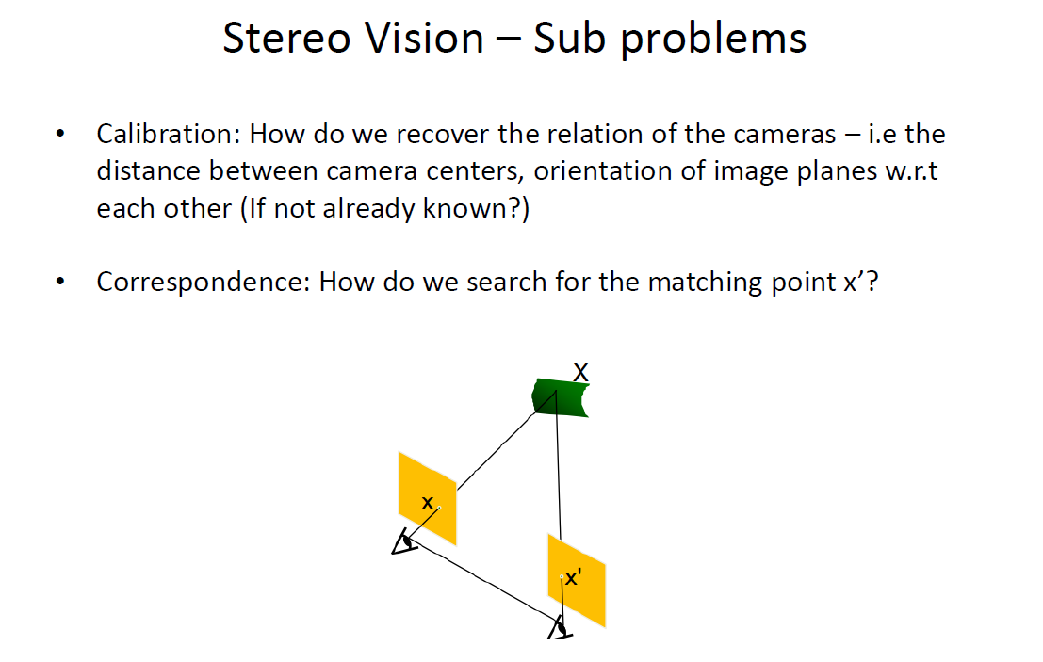

Slide 38
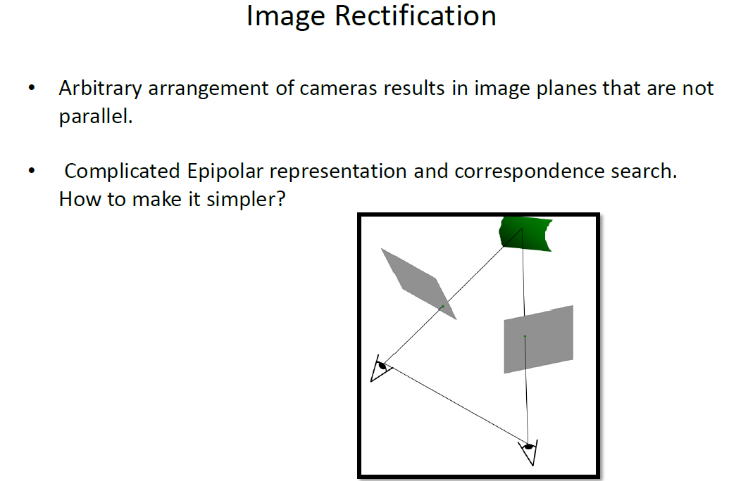

Slide 39
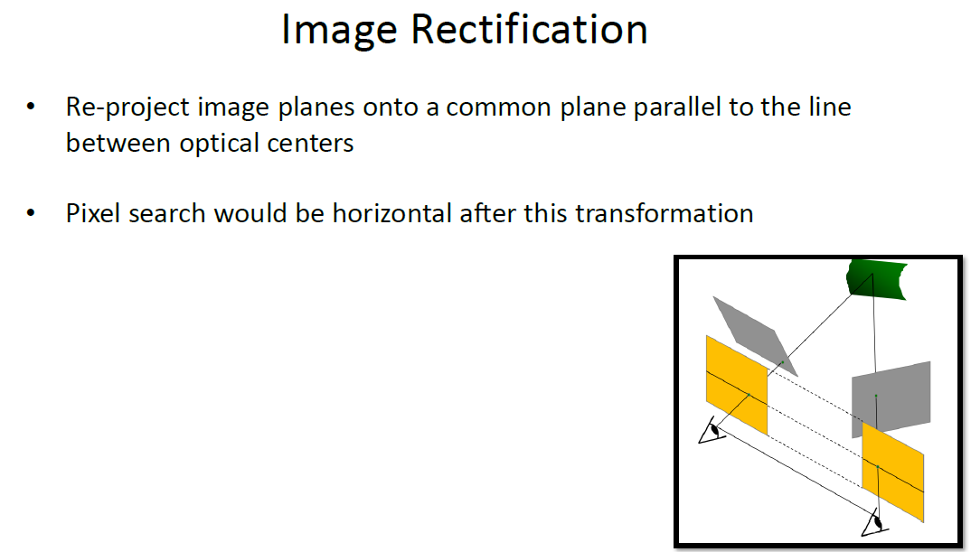

Slide 40
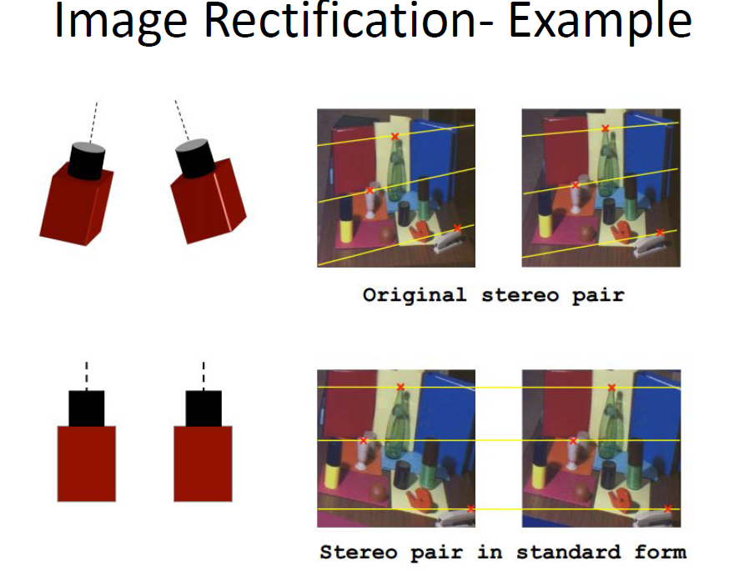

Slide 41
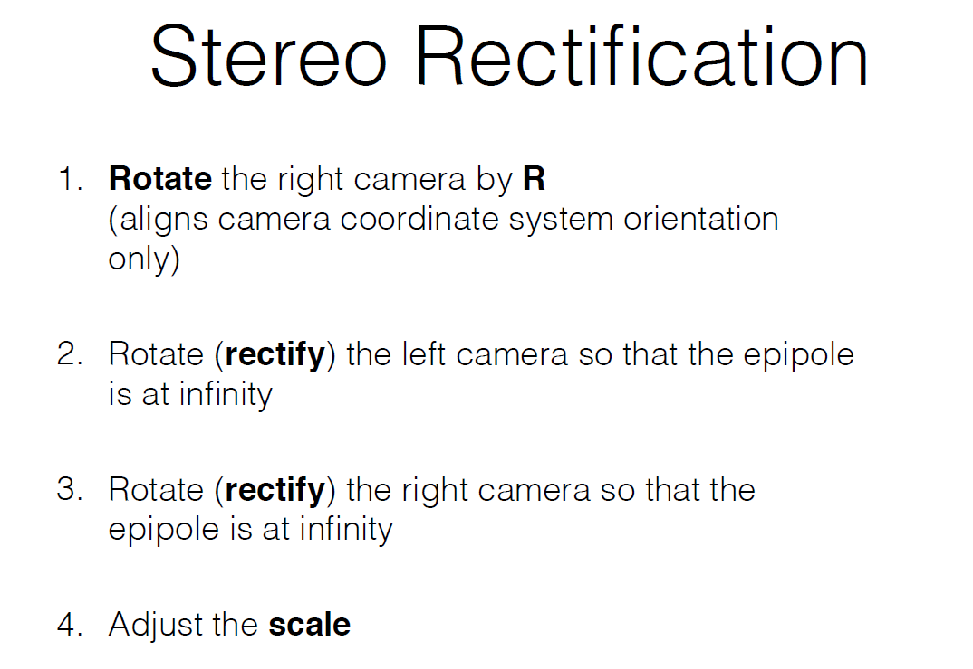

Slide 42
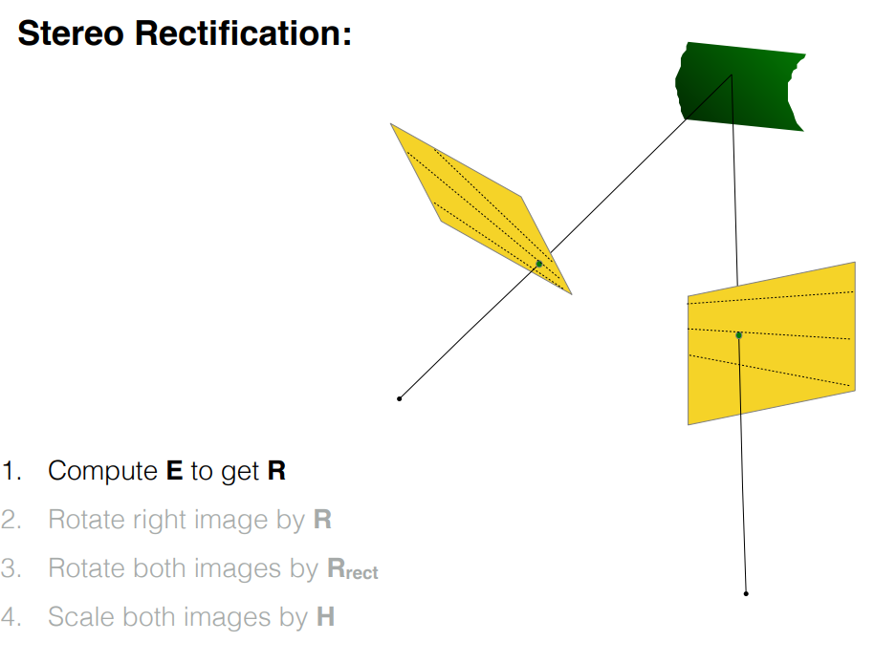

Slide 43
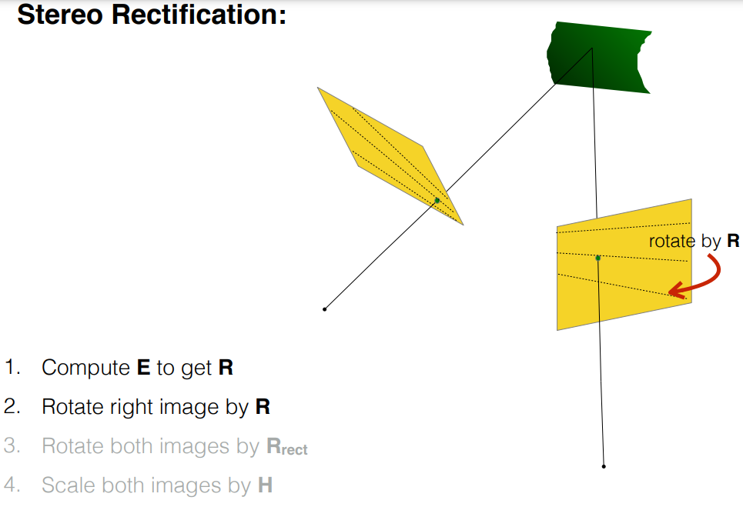

Slide 44
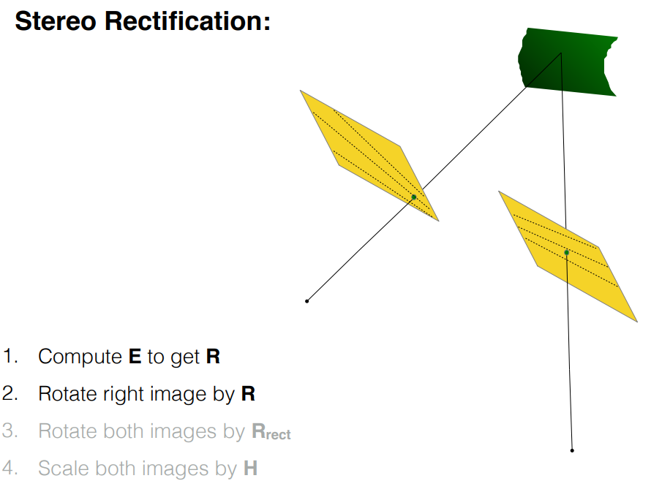

Slide 45
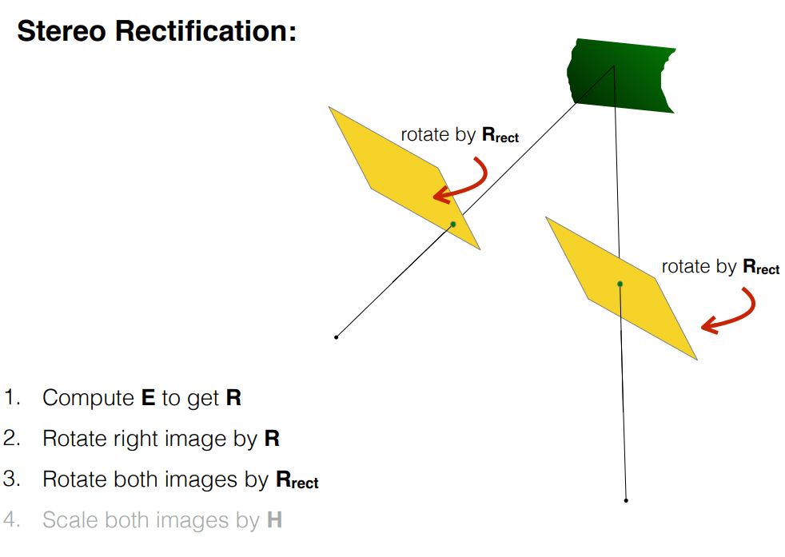

Slide 46
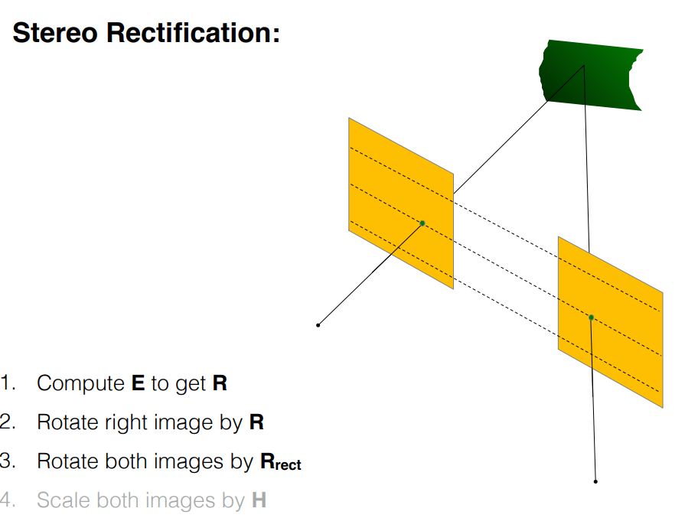

Slide 47
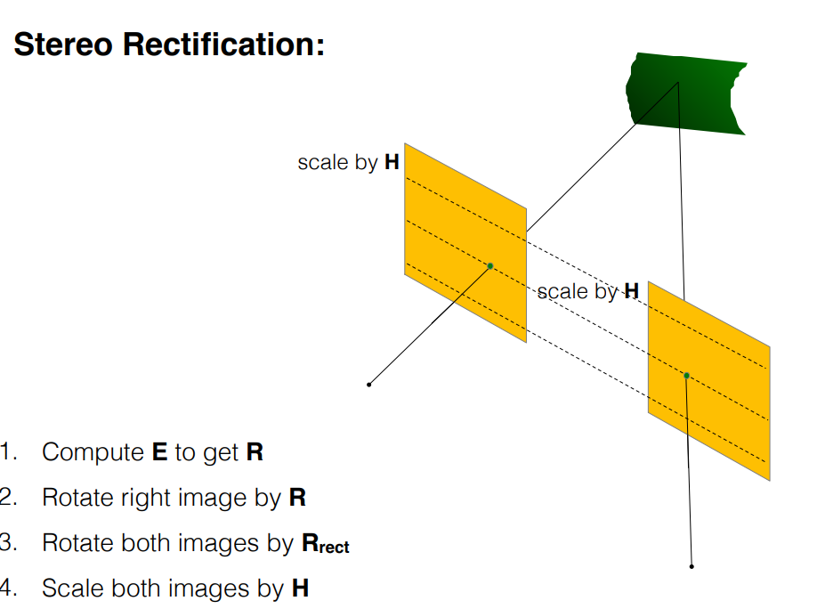

Slide 48
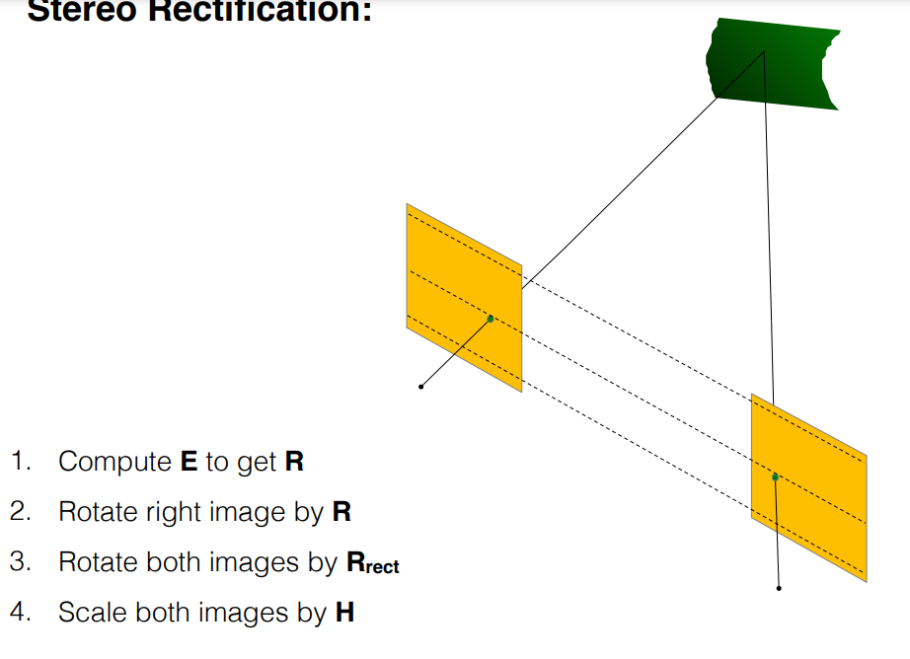

Slide 49
